Slide 1


Carlos Rey
21/11/2021

Slide 2

Outline
Executive Summary
Introduction
Methodology
Results
Conclusion
Appendix

Slide 3
Executive Summary
Methodologies:
Web Scrapping with BeautifulSoup
Data wrangling with pandas and numpy
First EDA with SQL
EDA and Preparing Data Feature Engineering
Location Analysis with Folium
Machine Learning Prediction with multiple models
Results:

Slide 4
Introduction
Rocket launches usually cost upward of 165 million dollars each.
SpaceX advertises Falcon 9 rocket launches will cost 62 million dollars this could be possible because of reusing first stage.
These savings could make possible easier and more reachable spatial research.
Can we determine which variables influence a successful first stage land?
Can we predict if a first stage will land?
Thus, can we ensure first stage savings?

Slide 5


Slide 6
Methodology
Executive Summary
Data collection methodology:
Web scraping from Wikipedia Falcon 9 historical launch records.
Perform data wrangling
Preprocess data and add a new column ‘class’
Perform exploratory data analysis (EDA) using visualization and SQL
Perform interactive visual analytics using Folium and Plotly Dash
Perform predictive analysis using classification models
How to build, tune, evaluate classification models

Slide 7
Data Collection – SpaceX API
Data collection from SpaceX API
Extract data
Data wrangling
Filter data frame
Deal with missing values
GitHub Repository
SpaceX API
From json to data frame
Create GET functions
Select and transform features
Select observations
Apply functions to obtain clean
data frame

Slide 8
Data Collection - Scraping
Extract Falcon 9 launch records HTML table from Wikipedia
Using BeautifulSoup
Parse HTML tables to create data frame
GitHub
SpaceX Scraping
Create functions to obtain wanted data
Request URL
Select table
Apply functions and store values in lists
Construct data frame from dict

Slide 9
Data Wrangling
Identification and sum of missing values per feature.
Identification of feature types.
Analysis of launches on each site.
Analysis of number and occurrence of each orbit.
Analysis of mission outcome number and occurrence per orbit type
Creation of new column which determine outcome:
Successful landing
Bad landing
GitHub
Data frame
Missing values
Features
Launches on sites
Orbits
Outcome feature

Slide 10
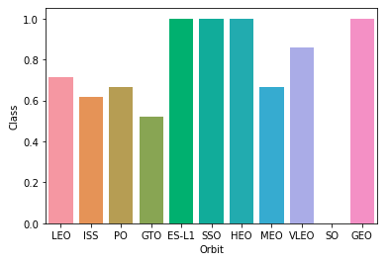
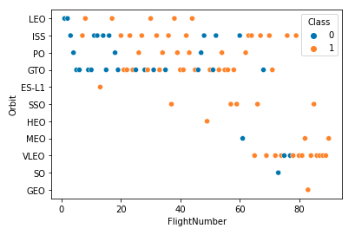
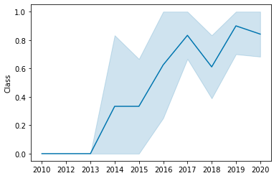
EDA with Data Visualization
Relation between Flight Number and Launch Site.
Relationship between Payload and Launch Site.
Relationship between success rate of each orbit type.
Relationship between Flight Number and Orbit type
Relationship between Payload and Orbit type
Launch success yearly trend
GitHub

Slide 11
EDA with SQL
Display names of unique launch sites.
Display 5 records where launch sites begin with the string 'CCA’
Display the total payload mass carried by boosters launched by NASA (CRS)
Display average payload mass carried by booster version F9 v1.
List the date when the first successful landing outcome in ground pad was achieved.
List the names of the boosters which have success in drone ship and have payload between 4000 and 6000.
List the total number of successful and failure mission outcomes
List the names of the booster versions which have carried the maximum payload mass
List the failed landing outcomes in drone ship, their booster versions, and launch site names for in year 2015
Rank the count of landing outcomes between the date 2010-06-04 and 2017-03-20
GitHub

Slide 12
Build an Interactive Map with Folium
I created and added:
Red circles and markers, to point cities.
Green markers, to point successful launch outcomes.
Red markers, to point unsuccessful launch outcomes.
Lines to calculate distance between near coastline and launch site.
Lines to calculate distance between near city and launch site.
GitHub

Slide 13
Build a Dashboard with Plotly Dash
I created:
A pie chart of total successful launches count for all sites and for every launch site.
Pie charts for each launch site showing success vs failed counts.
A scatter plot to show correlation between payload and launch success within a range (selected with a slider).
What can you visualize with these plots?
Ratio of successful launches for all launch sites and for each one.
Relationship between payload and launch success in selected payload range.
GitHub

Slide 14
Predictive Analysis (Classification)
Summarize how you built, evaluated, improved, and found the best performing classification model
You need present your model development process using key phrases and flowchart
Add the GitHub URL of your completed predictive analysis lab, as an external reference and peer-review purpose

Slide 15
Results
Exploratory data analysis results
Interactive analytics demo in screenshots
Predictive analysis results

Slide 16


Slide 17
Flight Number vs. Launch Site
Show a scatter plot of Flight Number vs. Launch Site
Show the screenshot of the scatter plot with explanations

Slide 18
Payload vs. Launch Site
Show a scatter plot of Payload vs. Launch Site
Show the screenshot of the scatter plot with explanations

Slide 19
Success Rate vs. Orbit Type
Show a bar chart for the success rate of each orbit type
Show the screenshot of the scatter plot with explanations

Slide 20
Flight Number vs. Orbit Type
Show a scatter point of Flight number vs. Orbit type
Show the screenshot of the scatter plot with explanations

Slide 21
Payload vs. Orbit Type
Show a scatter point of payload vs. orbit type
Show the screenshot of the scatter plot with explanations

Slide 22
Launch Success Yearly Trend
Show a line chart of yearly average success rate
Show the screenshot of the scatter plot with explanations

Slide 23
All Launch Site Names
Find the names of the unique launch sites
Present your query result with a short explanation here

Slide 24
Launch Site Names Begin with 'CCA'
Find 5 records where launch sites begin with `CCA`
Present your query result with a short explanation here

Slide 25
Total Payload Mass
Calculate the total payload carried by boosters from NASA
Present your query result with a short explanation here

Slide 26
Average Payload Mass by F9 v1.1
Calculate the average payload mass carried by booster version F9 v1.1
Present your query result with a short explanation here

Slide 27
First Successful Ground Landing Date
Find the dates of the first successful landing outcome on ground pad
Present your query result with a short explanation here

Slide 28
Successful Drone Ship Landing with Payload between 4000 and 6000
List the names of boosters which have successfully landed on drone ship and had payload mass greater than 4000 but less than 6000
Present your query result with a short explanation here

Slide 29
Total Number of Successful and Failure Mission Outcomes
Calculate the total number of successful and failure mission outcomes
Present your query result with a short explanation here

Slide 30
Boosters Carried Maximum Payload
List the names of the booster which have carried the maximum payload mass
Present your query result with a short explanation here

Slide 31
2015 Launch Records
List the failed landing_outcomes in drone ship, their booster versions, and launch site names for in year 2015
Present your query result with a short explanation here

Slide 32
Rank Landing Outcomes Between 2010-06-04 and 2017-03-20
Rank the count of landing outcomes (such as Failure (drone ship) or Success (ground pad)) between the date 2010-06-04 and 2017-03-20, in descending order
Present your query result with a short explanation here

Slide 33


Slide 34
<Folium Map Screenshot 1>
Replace <Folium map screenshot 1> title with an appropriate title
Explore the generated folium map and make a proper screenshot to include all launch sites’ location markers on a global map
Explain the important elements and findings on the screenshot

Slide 35
<Folium Map Screenshot 2>
Replace <Folium map screenshot 2> title with an appropriate title
Explore the folium map and make a proper screenshot to show the color-labeled launch outcomes on the map
Explain the important elements and findings on the screenshot

Slide 36
<Folium Map Screenshot 3>
Replace <Folium map screenshot 3> title with an appropriate title
Explore the generated folium map and show the screenshot of a selected launch site to its proximities such as railway, highway, coastline, with distance calculated and displayed
Explain the important elements and findings on the screenshot

Slide 37


Slide 38
<Dashboard Screenshot 1>
Replace <Dashboard screenshot 1> title with an appropriate title
Show the screenshot of launch success count for all sites, in a piechart
Explain the important elements and findings on the screenshot

Slide 39
<Dashboard Screenshot 2>
Replace <Dashboard screenshot 2> title with an appropriate title
Show the screenshot of the piechart for the launch site with highest launch success ratio
Explain the important elements and findings on the screenshot

Slide 40
<Dashboard Screenshot 3>
Replace <Dashboard screenshot 3> title with an appropriate title
Show screenshots of Payload vs. Launch Outcome scatter plot for all sites, with different payload selected in the range slider
Explain the important elements and findings on the screenshot, such as which payload range or booster version have the largest success rate, etc.

Slide 41


Slide 42
Classification Accuracy
Visualize the built model accuracy for all built classification models, in a bar chart
Find which model has the highest classification accuracy

Slide 43
Confusion Matrix
Show the confusion matrix of the best performing model with an explanation

Slide 44
Conclusions
Point 1
Point 2
Point 3
Point 4
…

Slide 45
Appendix
Include any relevant assets like Python code snippets, SQL queries, charts, Notebook outputs, or data sets that you may have created during this project

Slide 46


